Slide 1
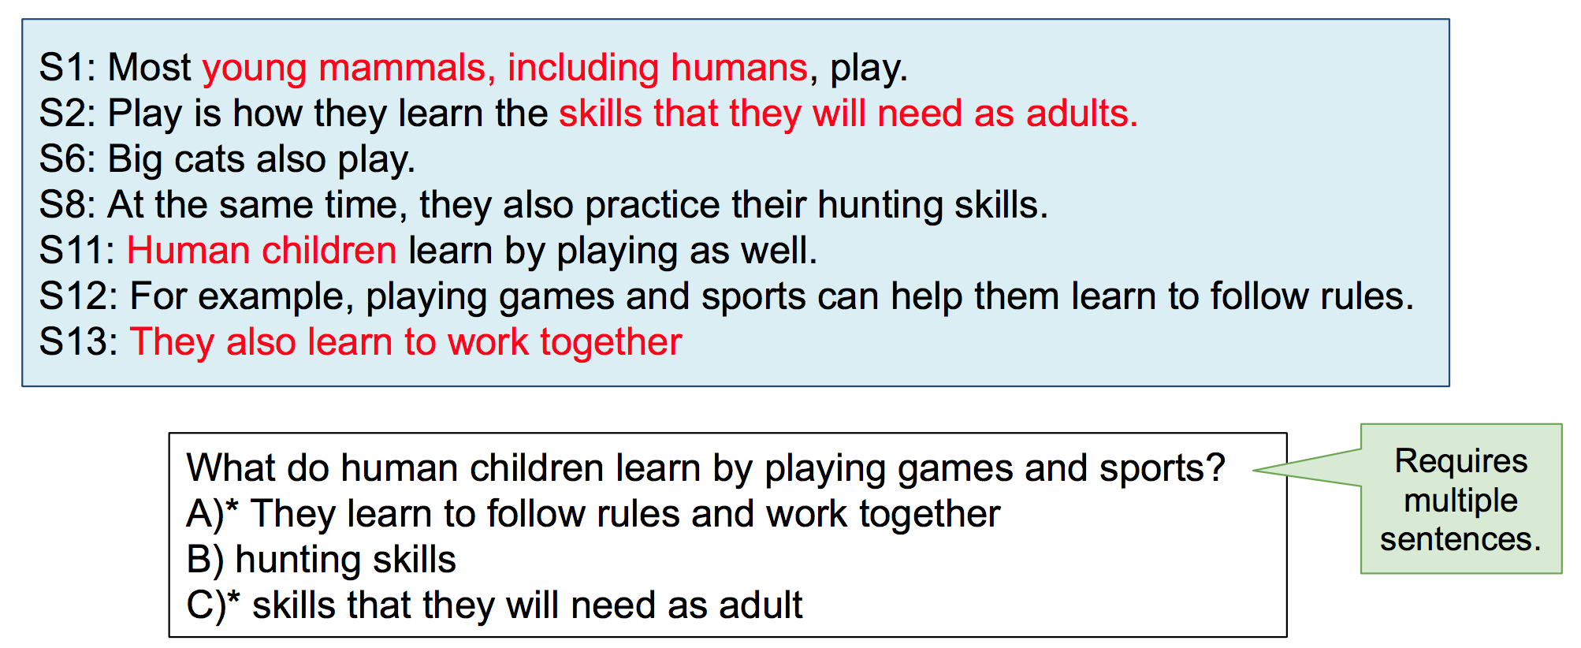
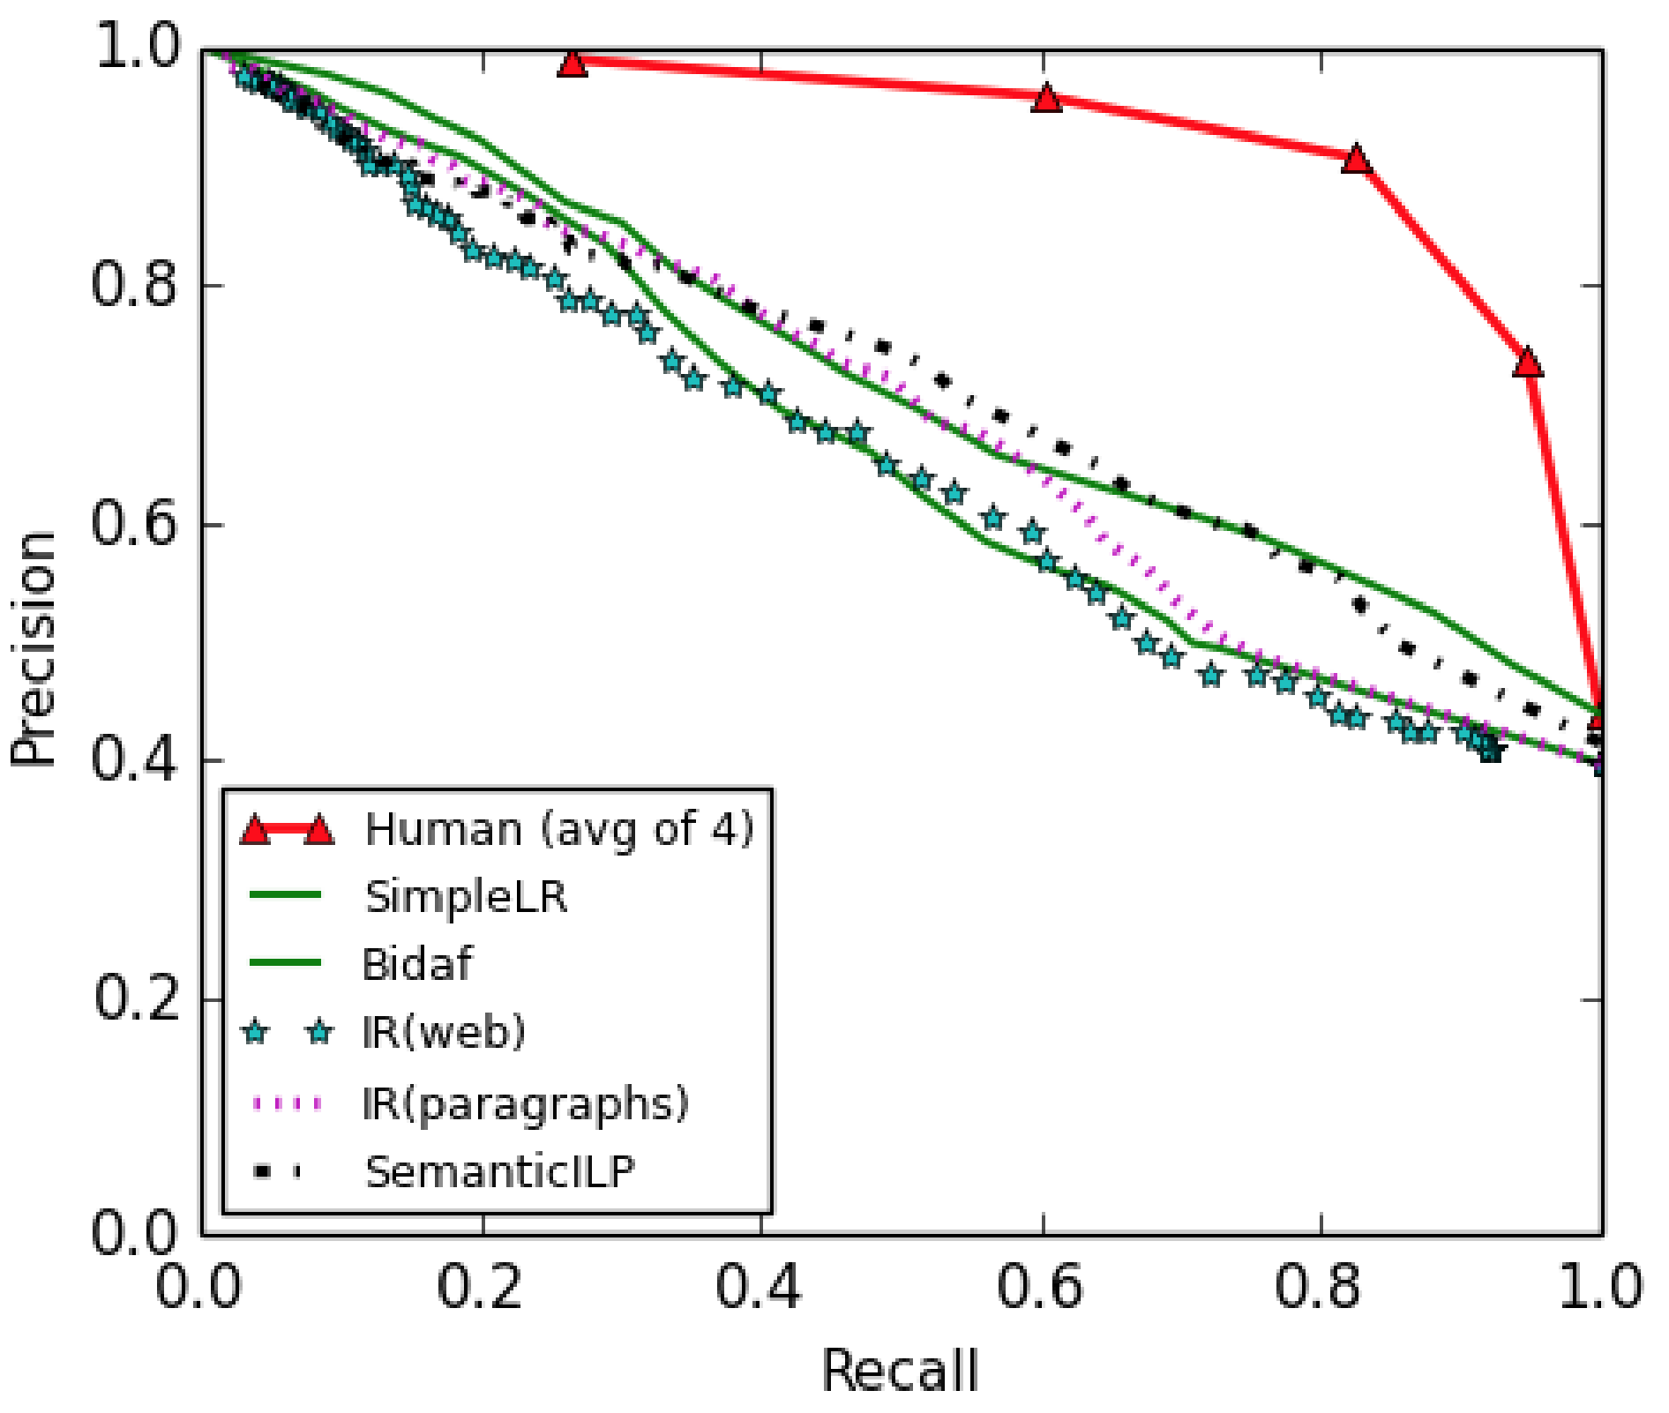
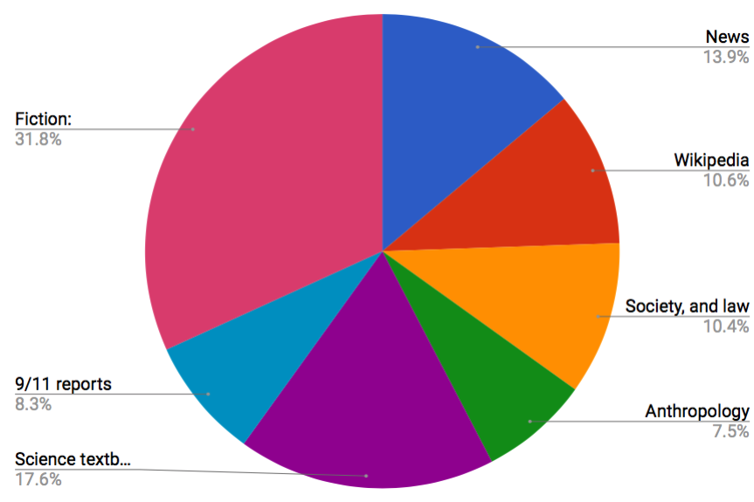
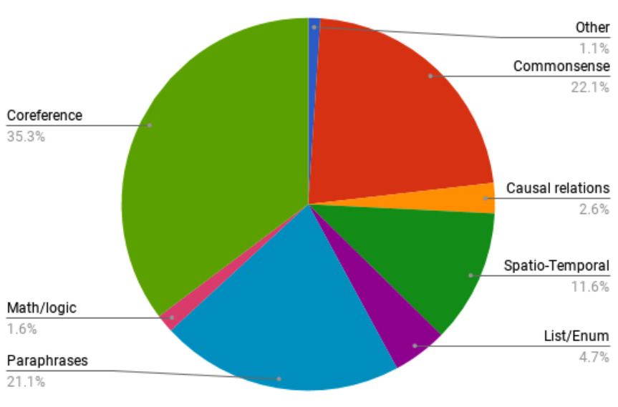
Looking Beyond the Surface: A Challenge Set for Reading Comprehension over Multiple Sentences
Daniel Khashabi¹, Snigdha Chaturvedi², Michael Roth³, Shyam Upadhyay¹, Dan Roth¹
¹University of Pennsylvania, ²University of California, Santa Cruz, ³Saarland University
Motivation
Quantitative Evaluation
Machine Comprehension is a fundamental challenge in AI.
Many challenge datasets in recent years: SQuAD, CNN/Daily Mail, NewsQA, etc.
Current QA systems do not have abilities comparable to human, as evident from their brittleness.
We believe that this is partly due to the absence of challenging datasets.
We propose to address this shortcoming by developing a reading comprehension challenge that requires reasoning over multiple sentences.
Random: Expected score upon random selection answers.
IR: Information retrieval baseline; each answer a is scored by sending a query question+a, to a Lucene engine that has indexed all the paragraphs in the training data.
SurfaceLR: Logistic Regression classifier, with features modelling word-overlap and other shallow features.
Human: Average of 4 human annotators
Example
Number of correct answers not specified
 | Dev (F1) | Test (F1)
Random | 44.3 | 47.1
IR | 64.3 | 54.8
SurfaceLR | 66.1 | 66.7
Human | 86.4 | 84.3
Dataset-collection Pipeline
~9,000 questions (6k are multi-sentence)
Extracted from +800 paragraphs
From 8 domains (fictions, news, science, social articles, Wikipedia, ...)
Website: https://cogcomp.org/multirc
Generate
Multi-sentence Questions
Multi-Sentence-ness Verification
Generating
Answer-Options
Quality Verification
Ask 5 people to write 3-5 questions such that the question is answerable from the passage
Ask turkers if they could answer the question, given a single sentence from the paragraph
Ask 3 turkers to create as many correct/incorrect answer-option as they can, for each question.
Ask turkers to indicate any errors (grammatical or otherwise) among questions and answer-options.
Design Principles
Multi-Sentence-ness.
Questions in our challenge require models to use information from multiple sentences
Open-endedness.
Not restricted to verbatim answers in a paragraph. Answer-options can represent information that is not explicitly stated.
Domains used in the dataset
Distribution of phenomena in the dataset
News
Other
PR curve for each of the baselines.
Fiction
Commonsense
There is a considerable gap between the performances of baselines and humans.
Answers to be judged independently.
The number of correct answer options is not pre-specified. Therefore, guessing an answer by elimination or choosing the top candidate is not sufficient.
Wikipedia
Coreference
Society and Law Articles
Causal Relations
Spatio/Temporal
Acknowledgements
Variability.
Our paragraphs are from multiple domains, leading to linguistically diverse questions and answers.
“Sept 11” reports
Anthropology
Math/Logic
Partly based on research sponsored by
German Research Foundation (DFG EXC 284 and RO 4848/1-1)
DARPA under contracts FA8750-13-2- 0008 and HR0011-15-2-0025
Allen Institute for Artificial Intelligence (allenai.org)
Google
NSF grant BCS-1348522; and by NIH grant R01-HD054448.
Science Textbooks
Paraphrase
List/Enumeration

